Slide 1
Week Four / Module 4
Video Assignment
My PICOT Problems and Evidence-Base Practice
Barbara A. Gibbs, RN
Department of Nursing Laboure College of Healthcare
Nursing 4336 Evidence-Base Practice II Nursing
Professor: Jo Anne Foley RN DNP CNE CNEd CCRN NPD-BC October 1, 2024

Slide 2
Hello, My name is Barbara A. Gibbs. I am currently employed for nine years
Twenty hours per week at Dimock Community Health Center.
My PICOT Research Project is to evaluate the current charting system at the five residential programs and suggest ways to improve it. The goal is to decrease the time spent on charting and the amount of paper used.
What do I do when I review the patient records and the charting system?
I reviewed the doctor's orders for all twenty-three patients, the patient medication in the blister packs to make sure the label on the blister packs is the same as the doctor's orders, and the daily medication records sheet to make sure the medication order was transcribed correctly. I also reviewed other documents in the patient chart.
This project led me to research Electronic Medical Records and Electronic
Health Records. In my research. I realized that five residential houses are not connected to Dimock’s central campus computer system; email is the only computer connection for the residential program.

Slide 3
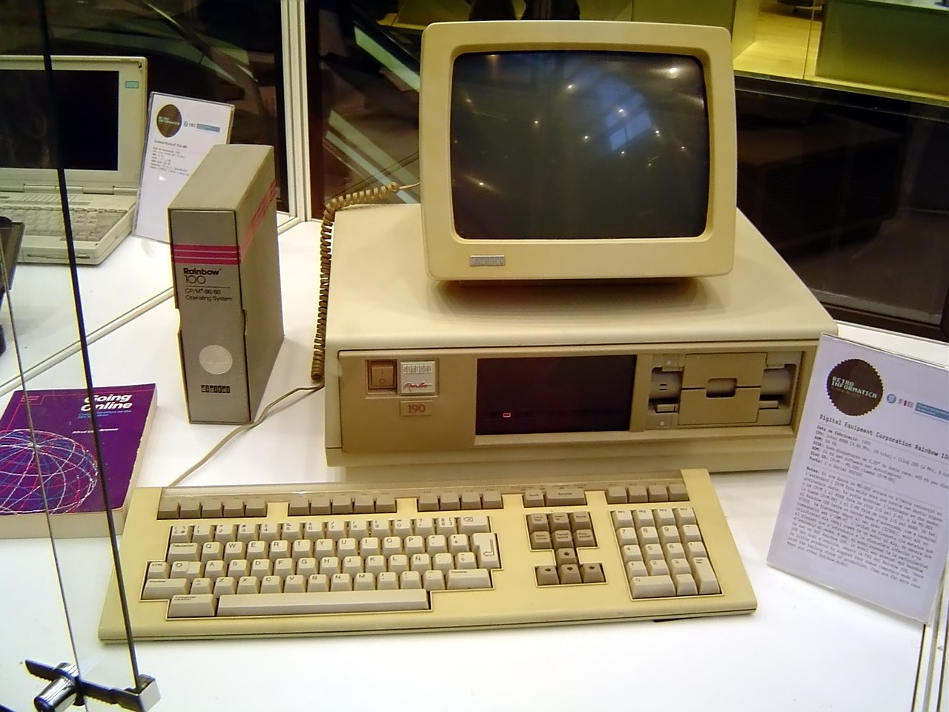
OLD PAPER MEDICAL CHART
COMPUTER
This Photo by Unknown Author is licensed under CC BY-SA
This Photo by Unknown Author is licensed under CC BY-SA

Slide 4
Week 4 Part 1Video Progress Assignment
1. This is what I have done on my project
a. Evidence-Based Practice 1 Module 5 Week 5 submitted PICOT
Research topic: Health Care Workers at an Assistant Living Group Home
Professor Virginia Mason and Professor JoAnn Foley approved the research project topic.
b. First week of EBP II Week 1Module 1and Week 2 Module 2
Introduction to professor and classmates defined EBP, identified my PICOT problems, and gave an overview of the culture of my place of employment.
c. Conference call was made to my supervisor requesting permission to do my research project at the five assistant living houses I cover.

Slide 5
This is what I have done on my project
9/5: Emailed copy of Mentorship and Mentee Guideline to Margaret and Tom
9/7: Emailed PICOT questions to Margaret and Tom
9/16: Emailed from Tom with the comment on PICOT questions
9/20: Emailed from Tom, inviting me to the Zoom staff meeting on 9/23/24 at 1:PM to explain the PICOT research question and suggest changes to staff members.
9/23: Zoom staff meeting-------2hrs
9/17 through 9/19: Visited five assistant living programs and reviewed 23 patient charts, doctor's orders, and medication in blister packs from the pharmacy, medication documentation sheet, and control substance books.-----20hrs
9/21: I emailed a copy of my log to my mentors. The total hours spent on my project were 22.50 hours.

Slide 6
This is what I need to finish up on
I need to finish all of the upcoming week's assignments
Week 4 Module 4 and
Week 5 Module 5
Week 6 Module 6
Week 7 Module 7
Institute for Healthcare Improvement Question 103 PDSA cycle and Question 105 leading Quality Improvement.
My tangible products. Due 10/15/24 at 6 pm

Slide 7
My tangible products are.
Form used in patient chart
Personal fact sheet
Doctor order form
Medication sheet
Medication progress notes
Healthcare appt forms
New prescription order form
Verbal telephone order form
Daily bowel movement sheet
Daily temperature recording sheet
Daily blood pressure recording sheet
I will have my mentor assist me with My ADOBE Presentation / Poster and Log 2

Slide 8
Discuss how I was a leader in my project.
When I learned in EBP 1 that I would have to do a research project in EBP11, I immediately thought of researching patients' compliance with Dialysis treatment. However, I was told that using patients in a research study would require too much work because the research would have to be submitted to the IRB for review and approval.
Did I take the lead on my research project? After deciding what research topic I wanted to research (looking at the charting system at the residential program), I wrote up my research proposal. I submitted it to Professor Mason and Professor Foley. After their approval, I called my supervisor at Dimock. He agreed to help, and I emailed the research proposal to him. His feedback was good, and he said he would look forward to working with me. I also call my friend a nurse who has mastered a doctorate in nursing. She agreed to be my mentor as well. I zoomed in to our staff meeting on 9/23/24 at 1:PM to present my research project to the house managers.
(see my week three log) I would say that I took the lead on this research project.

Slide 9
Dimock Community Health Center Electronic Clinical Records
The research project I chose is to look at the charting system used by the five residential programs I cover monthly, which led me to do in-depth research on electronic medical records. I realize that the Dimock residential houses do not use any computer system other than email to communicate with doctors and other staff members concerning the residents in these homes; the residential houses are not connected to the Dimock main campus electronic medical /clinical system. I called Dimock IT Department to ask what electronic medical system is used. I was told that the system's name is Electronic Clinical Works; my other question was why the residential houses were not a part of the Electronic Clinical Works used by the main campus. I was told that it is something that is being worked on, and the other reason was cost. When it does happen, the residential houses would probably have to have their own server or their own web-based internet connection.

Slide 10
Dimock Community Health Center Electronic Clinical Records
If the residential houses were using the same system as Dimock main campus, it would be a great help to the staff at the residential program by decreasing the amount of paper that is used on a monthly and yearly basis because every month, all of the monthly records have to be replaced by new records, i.e., medication sheets approximately 5-10 sheets per patient, medication progress notes sheets, bowel tracking sheets to name a few. Each patient's information is placed in a big envelope and stored in the house manager's office. Storage space for these documents is a significant problem for these houses.

Slide 11
Dimock Community Health Center Electronic Clinical Records
According to the article posted by Business, Innovation, Technology, Society by Steve Lohr on February 17, 2012, titled "The Miracle of Digital Health Records 50 Years Ago," Dr. Lawrence L. Weeb is most widely credited with developing the first electronic medical record, the so-called Problem-Oriented Medical Information System (Promis), starting in 1969 while he was working at the University of Vermont.
Yet a couple of years later, Mr. Sherman said the results from the computerization initiative were encouraging, as he describes in this video posted on YouTube. The benefits included quality-of-care improvements that are selling points for today’s electronic health records, like monitoring drug dosages and preventing harmful drug interactions.

Slide 12
Dimock Community Health Center Electronic Clinical Records
While researching electronic medical records (EMRs), I learned there are also electronic health records (EHRs). A video presentation by Doug Bonderud on the difference between the EMR and EHR. The EMR is a digital replacement for a patient paper chart used for diagnosis, medication, and patient history. Inter-office EMRs are not designed to be used with other practices; they are inter-office. The EHR includes all of the information in an electronic medical record, and more EHRs are designed to be shared with other providers and aid the level of care across the care continuum. Oracle Cerner and Epic are the two major Electronic Health Record systems used by thousands of hospitals and clinics in the United States and other parts of the world.

Slide 13
Video presented on Electronic Medical Records by Dr. Eric Bricker
https://youtu.be/3TdSKr81III?feature=shared
Video presentation on Electronic Medical Records and Electronic Health Record
https://youtu.be/y85HfTG4UpU?feature=shared
Larry Weed's 1971 Internal Medicine is credited with developing the first electronic medical record.
YouTube
VisualDx
77K views
Jun 22, 2012

Slide 14
This Photo by Unknown Author is licensed under CC BY-SA
Notes:
Modern Day Computer Server

Slide 15
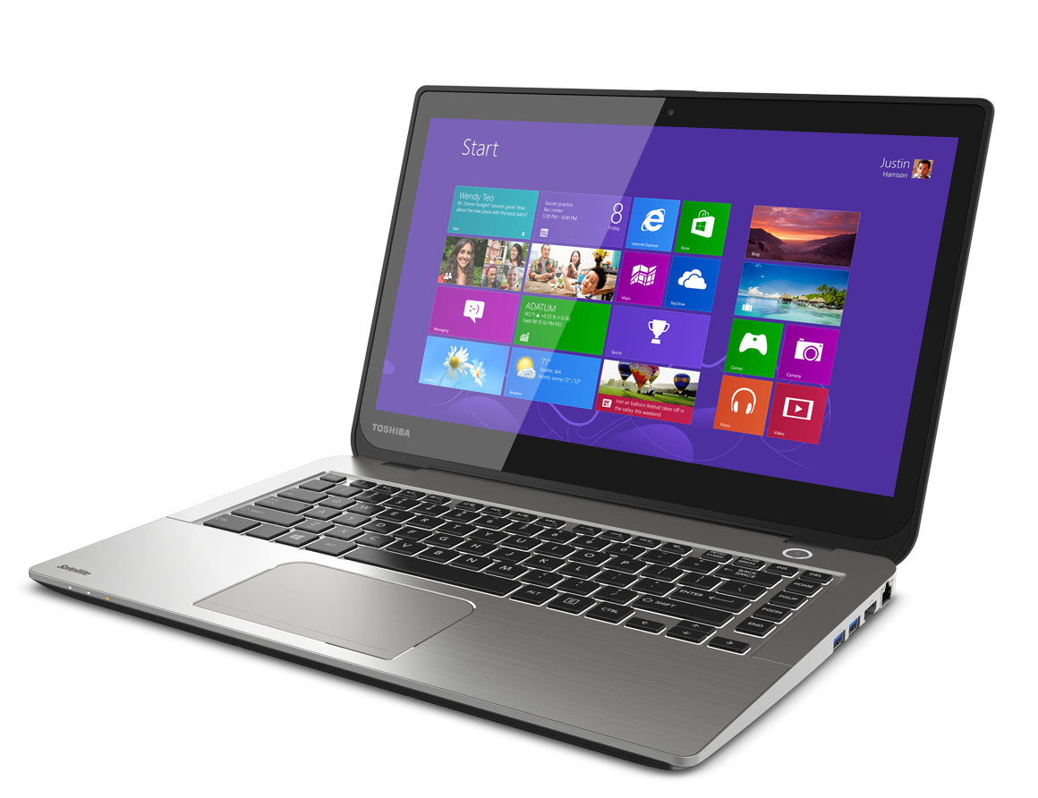
This Photo by Unknown Author is licensed under CC BY-NC
Notes:
Modern Day Lap Top Computer

