Slide 1
Senior Capstone
Lifelong Learning Presentation
Barbara A. Gibbs, RN
Department of Nursing Laboure College of Healthcare
Nursing: SES4355
Professor: James Latta, Ph.D.
Assistant Professor of Arts and Health Sciences
December 6, 2024

Slide 2
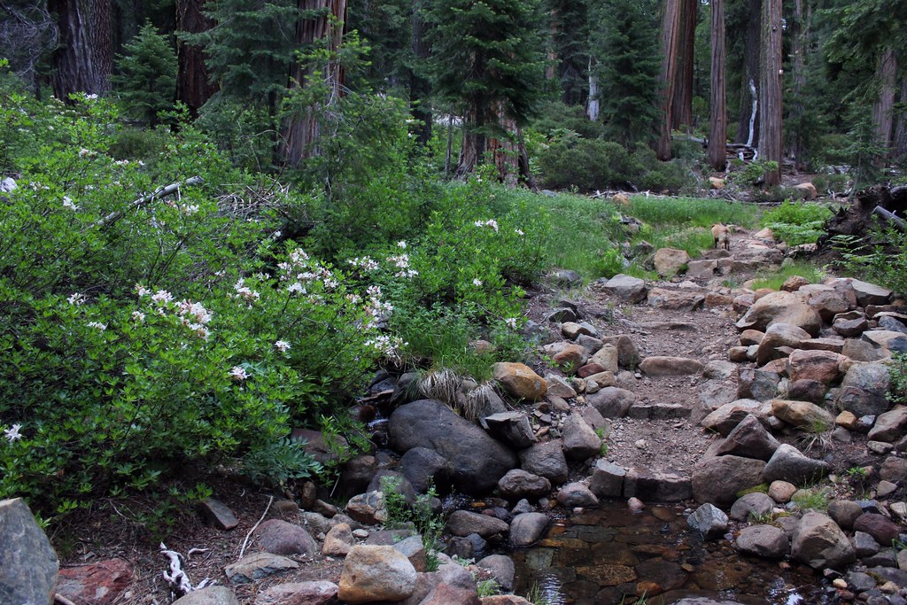
This Photo by Unknown Author is licensed under CC BY-NC
This Photo by Unknown Author is licensed under CC BY

Slide 6
This Photo by Unknown Author is licensed under CC BY-SA

